Slide 2


Slide 3
Thermal energy is…
An example of a “source” of thermal energy is…

Slide 4
Conduction transfers heat by…
Radiation transfers heat by…
Convection transfers heat by…

Slide 5
The air above the stove will…
The person’s hand will…
The burner on the stove will…

Slide 6
Conduction is…
The image shows conduction because…

Slide 7
Convection is…
This image shows convection because…

Slide 8
Radiation is…
This image shows radiation because…

Slide 9

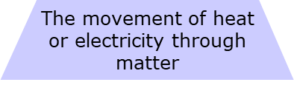
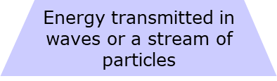

Slide 10
An example of how radiation is transformed into other forms of energy is…

Slide 11
One more example of conduction is…

Slide 12
The attic of a house is normally hottest because…

Slide 13
It is no longer radiation because…

Slide 14
Conduction
Convection
Radiation
Conduction
Convection
Radiation
Conduction
Convection
Radiation
Conduction
Convection
Radiation
Conduction
Convection
Radiation
Conduction
Convection
Radiation

Slide 15
The location and design of a house can help control temperature because…

Slide 16
Type your answer here
Type your answer here
Type your answer here
Type Here
Type Here
Type Here
Type Here

Slide 17
Conduction is…
A few examples of conduction are…
Convection is…
A few examples of convection are…
Radiation is…
A few examples of radiation are…
Notes:
Clear up any confusion and answer questions.

Slide 18
Type your answer here

